Slide 1
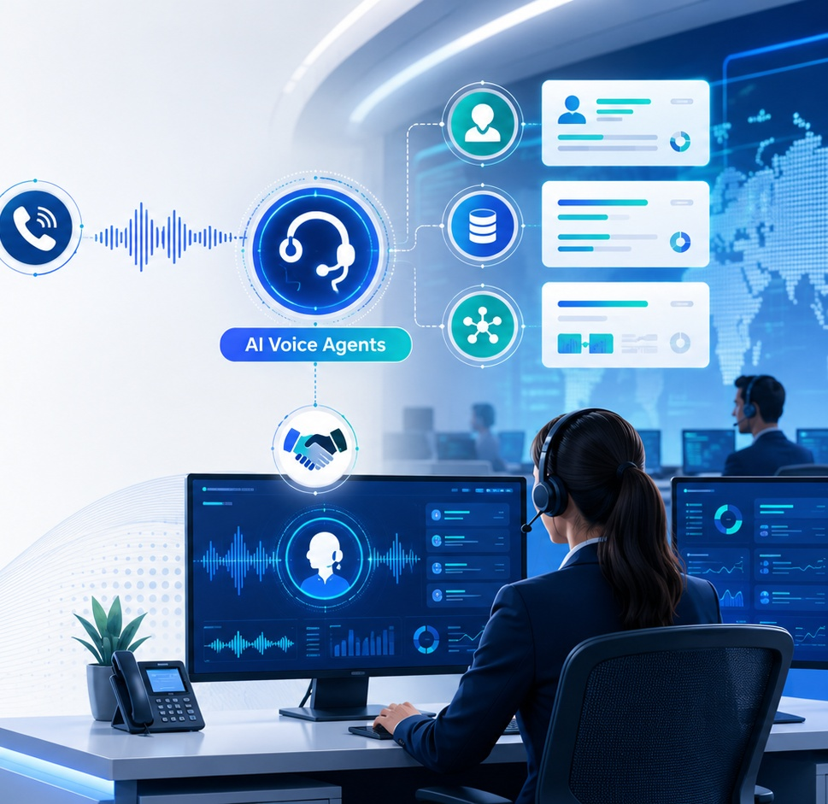
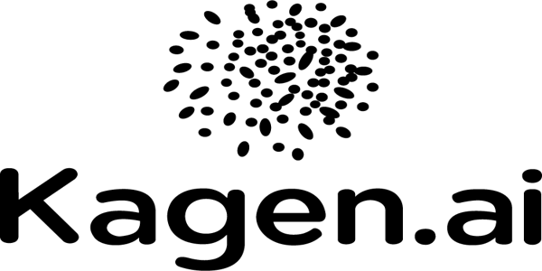
ENTERPRISE AI VOICE AGENTS
AI Voice Agent
Architecture
A playbook for enterprise-ready automated customer conversations, from real-time speech understanding to workflow execution.
Architecture • Benefits • Use Cases • Kagen VOICE
kagen.ai | AI Voice Agents
01
Notes:
Source: https://www.kagen.ai/blog/ai-voice-agents-architecture-benefits-use-cases

Slide 2

Market Shift
Why AI voice agents are becoming a business imperative
Customer expectations are outpacing queue-based support models.
80%
Common customer service issues projected to be resolved autonomously through AI by 2029.
$4.4T
Potential annual business value from AI-driven automation across operations and sales.
24/7
Real-time, multilingual customer conversations without linear workforce expansion.
Pressure points AI voice agents solve
Immediate response expectations
Fragmented data access across tools
Support and sales scaling tied to headcount
kagen.ai | AI Voice Agents
02
Notes:
Based on Kagen AI blog sections on customer expectations, economic pressure, and Gartner/McKinsey references.

Slide 3
Foundation
What is an AI voice agent?
A real-time conversational system that understands speech, interprets intent, generates natural responses, and executes business actions.
1
2
3
4
Understand
Interpret
Respond
Execute
Natural speech, accents, language, and noisy environments.
Intent, entities, and context across multi-turn conversations.
Human-like responses with tone, clarity, and consistency.
CRM, scheduling, payment, support, and workflow actions.
More than IVR: AI voice agents manage complete workflows, access enterprise systems, and make decisions within defined parameters.
kagen.ai | AI Voice Agents
03

Slide 4
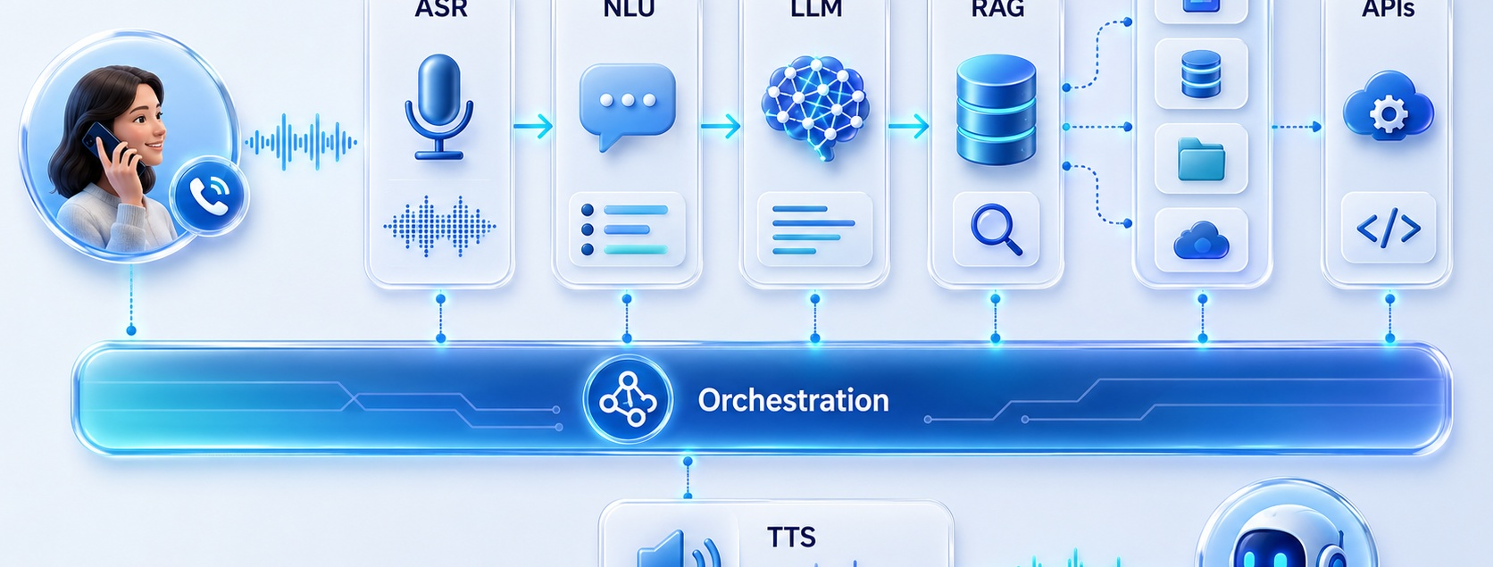
Architecture
Reference architecture: from voice to action
Enterprise AI voice agents are orchestrated ecosystems — not a single tool.
kagen.ai | AI Voice Agents
04

Slide 5
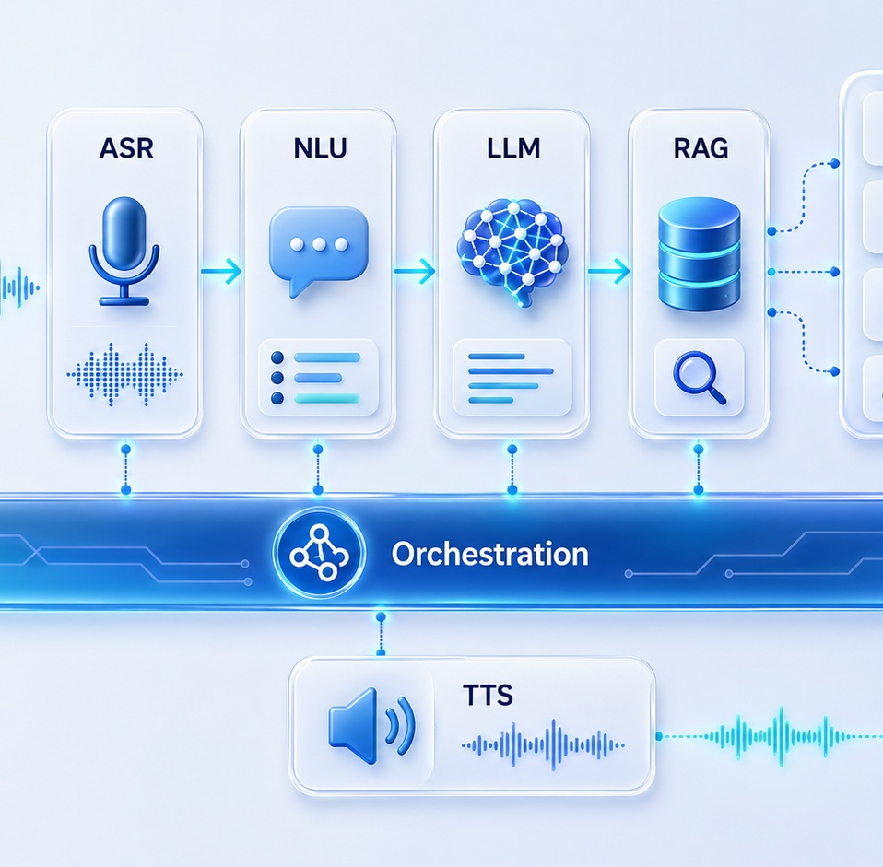
Scale Risk
The orchestration challenge: where pilots break
The hardest part is coordinating every layer fast enough for natural conversation.
Latency
Transcription, retrieval, reasoning, and response generation all add delay.
Fragmentation
Conversation logic, data access, and workflows often operate in silos.
Real-world dialogue
Interruptions, topic switching, and multi-turn context are hard to handle.
Production load
What works in a pilot can fail when call volume increases.
kagen.ai | AI Voice Agents
05

Slide 6
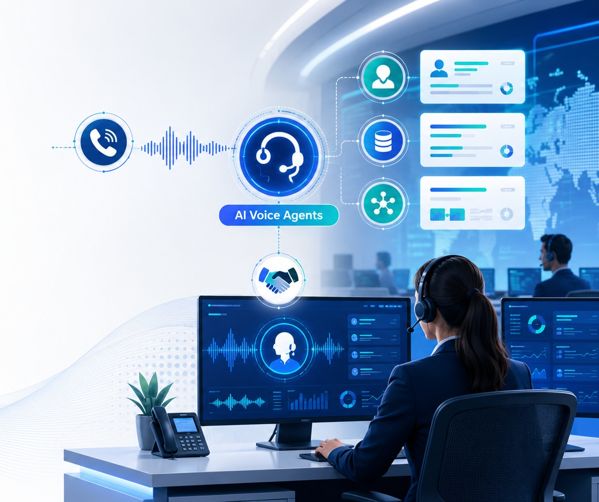
Platform
Kagen VOICE: enterprise AI voice delivered
Kagen VOICE combines orchestration, integration, and intelligence into a managed voice AI platform for enterprise calling.
Sub-800ms latency
Natural flow without noticeable delays
Barge-in & turn-taking
Handles interruptions and context switching
Multi-provider optimization
Balances reliability, cost, and performance
Enterprise integrations
CRM, contact center, telephony, databases
Security & governance
Designed for enterprise compliance needs
kagen.ai | AI Voice Agents
06

Slide 7
Use Cases
High-value use cases across enterprise workflows
eCommerce
Customer Support
BFSI
Cart recovery, order status, returns
Authentication, FAQs, troubleshooting, resolution
Loan journeys, reminders, collections
Healthcare
SaaS & B2B
Scheduling, rescheduling, patient follow-ups
Lead qualification, routing, call summaries
AI voice agents shift calls from handling queries to resolving outcomes.
kagen.ai | AI Voice Agents
07

Slide 8
NEXT STEP
From automation
to autonomous
customer operations
Kagen VOICE brings real-time conversational intelligence, enterprise integrations, and managed delivery into one scalable AI calling layer.
Book a Demo at kagen.ai
kagen.ai | AI Voice Agents
08

